Slide 1







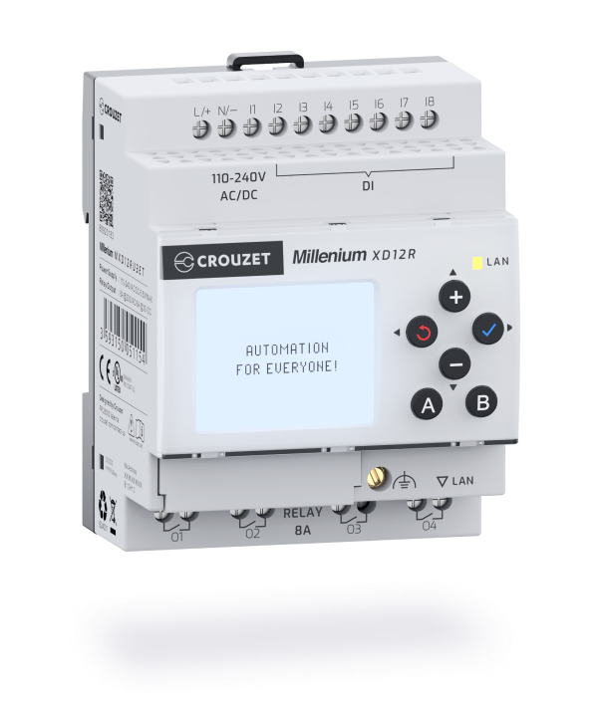



2025
The New
Millenium
®

Slide 2




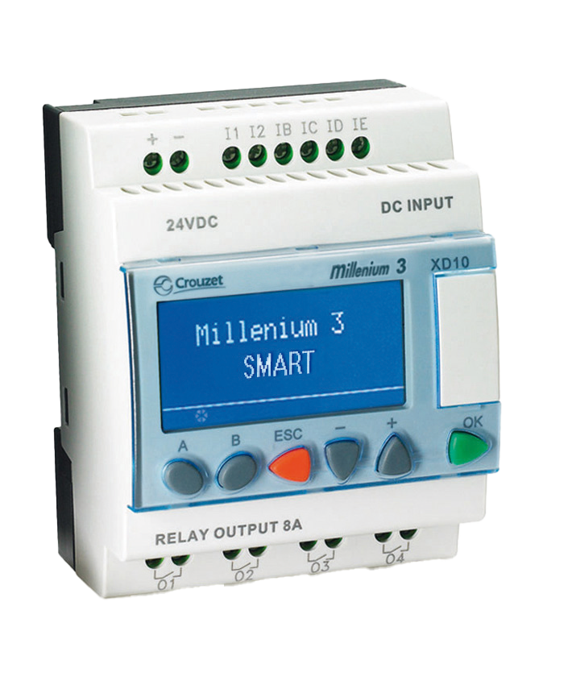

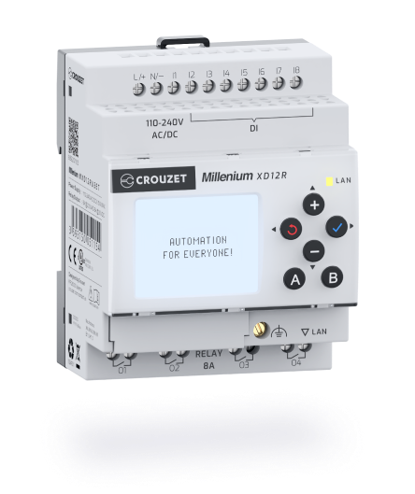







Discover the evolution
Integrated Ethernet
port TCP/IP
Modbus RS-485 port
optional
Memory interface
with SD card
Read more
Read more
Read more
x2
I / O
Doubled
internal memory
Up to 60
inputs/outputs
3-color display
on 6 lines
Webserver
Read more
Read more
Read more
Read more

Slide 3




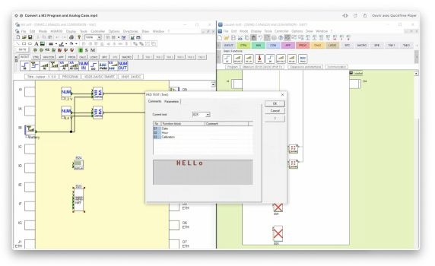







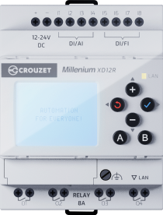



PROGRAMM TRANSFER
Millenium 3 Soft to Crouzet Soft
Software upgrade with new features
A more intuitive user interface
A simple 4-step transition:
1
Download and install Crouzet soft
available on Crouzet.com
3
Open your existing program
2
Select the equivalent controller
4
Adapt inputs/outputs and edit
Download the transition kit

Slide 4



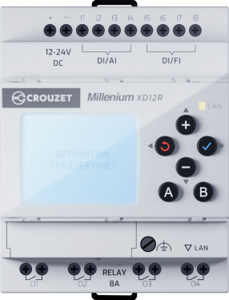
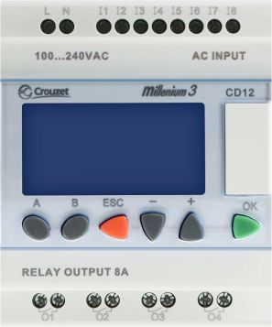




Detailed comparison of logic controllers
Millenium 3
New Millenium
1 - COMMUNICATION
2 - INTERCHANGEABLE INTERFACE
3 - INPUTS / OUTPUTS
4 - PROGRAMMING
5 - DISPLAY SPECIFICATIONS
6 - NAVIGATION

Slide 5

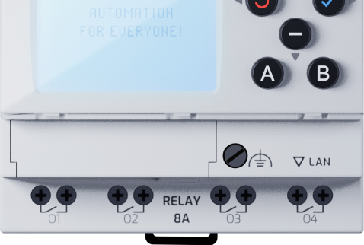




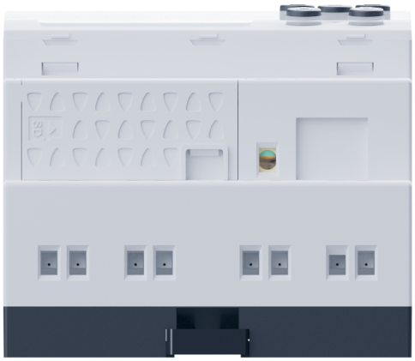
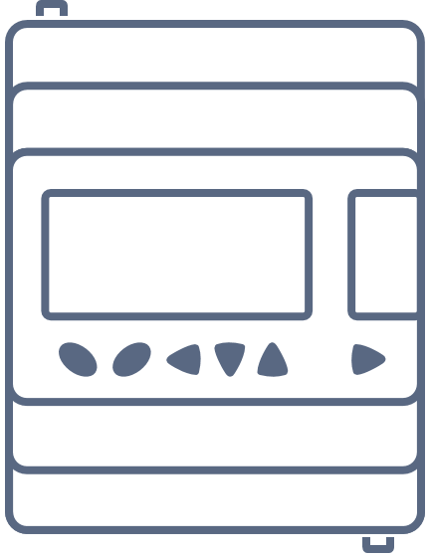

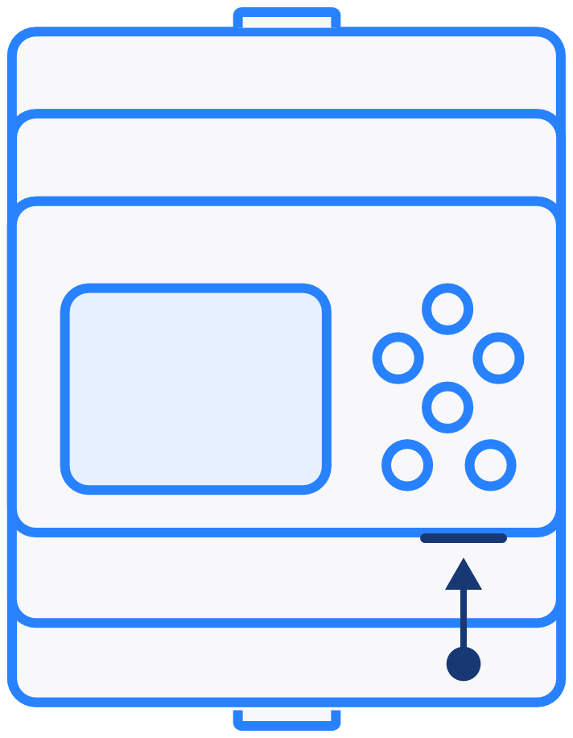







COMMUNICATION
Built-in Ethernet
1
No expansion module needed
Millenium 3
New Millenium
Expansion
Ethernet TCP/IP port
RJ45
Integrated Ethernet TCP/IP port

Slide 6

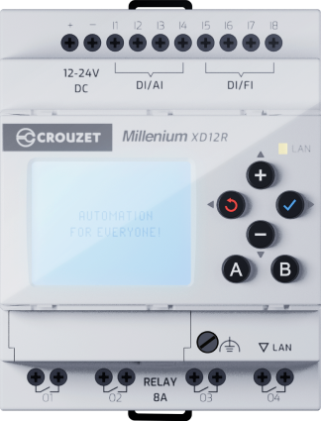




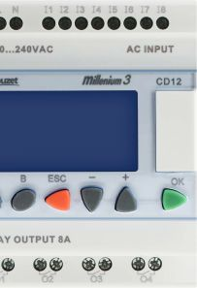






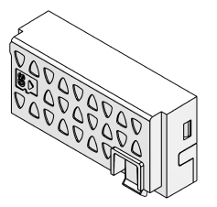




INTERCHANGEABLE INTERFACE
MODBUS RS 485 & SD card interface
2
New Millenium
Millenium 3
x2
Doubled
internal memory
RS 485
MEMORY
CARD
Extend your PLC memory, perform data, or load a new program
Modbus RS 485 available on base thanks to an interface
Up to 2,000 function blocks
The 2 models have a memory cartridge
*SD card not included

Slide 7
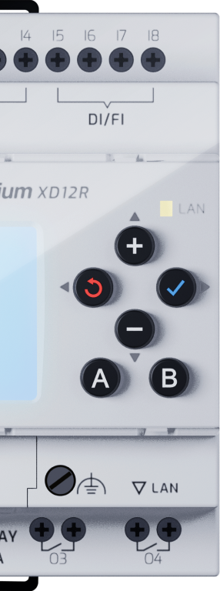

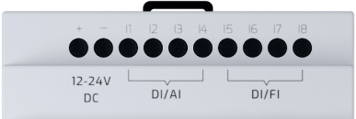


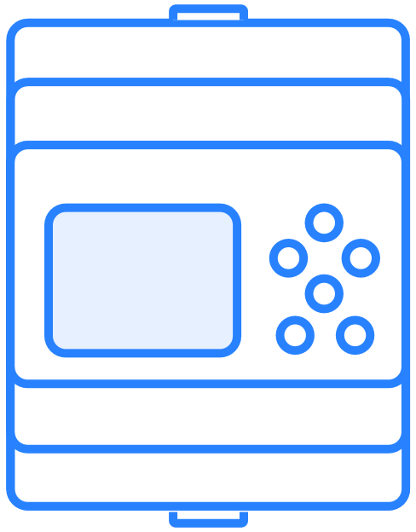
















INPUTS / OUTPUTS
Up to 60 I/Os
3
mA
x12
Multiple Input Types
Digital
Analog
High-speed
4 - 20 mA
Add up to 12 expansion modules*
Relays
SSR / PWM
Outputs
*please refer to the datasheet or configurator to find your solution

Slide 8






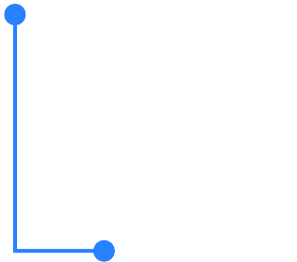

INPUTS / OUTPUTS
Up to 60 I/Os
3
Relays
SSR / PWM
Outputs
mA
x12
Add up to 12 expansion modules*
Multiple Input Types
Digital
Analog
High-speed
4 - 20 mA
*please refer to the datasheet or configurator to find your solution

Slide 9

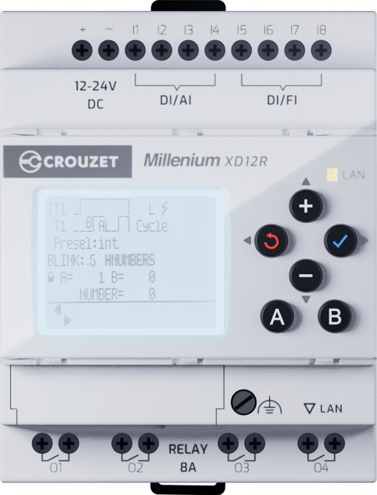







PROGRAMMING
2 programming modes
4
Visual Function Block programming
More than 2000 FBD (5 times more than market leader)
Ladder, front face programming
Transfer multiple programs at once
SD card, Laptop and cable

Slide 10







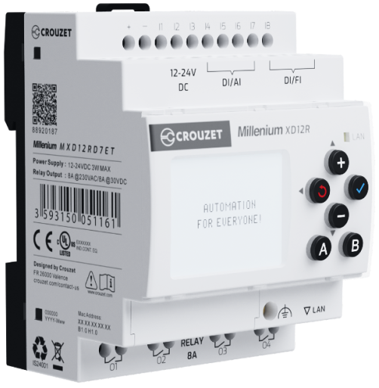

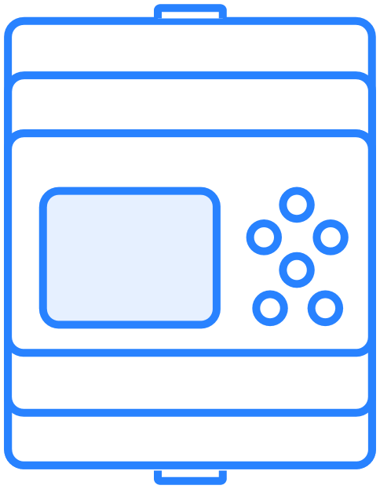
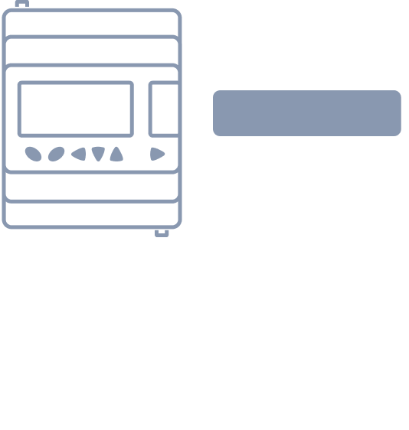





DISPLAY SPECIFICATIONS
Improved visualization
5
Status color changing screen :
White, green or orange to easily identify alarm and alert status
New display
More information
Tri-color screen
New Millenium
Millenium 3
6 lines
24 characters/line
3 colors
4 lines
18 characters/line
1 color

Slide 11

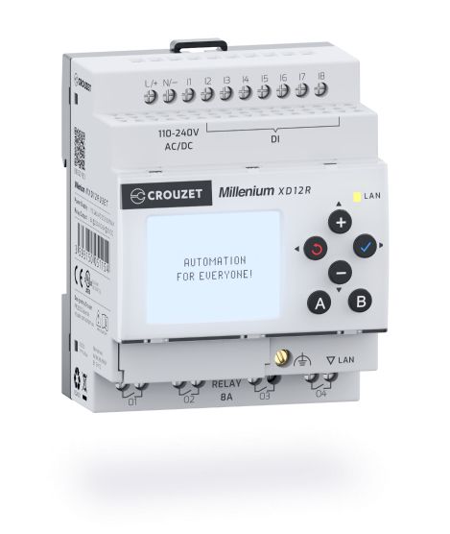




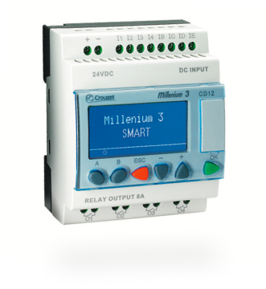


NAVIGATION
Same buttons, new usability
6
New Millenium
Easy access to your data and process thanks to our new navigation interface
A
B
Millenium 3
A
B
ESC
OK
*SD card not included

Slide 12


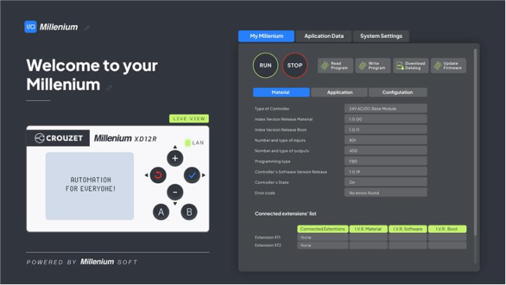





PRODUCT SETTINGS
Access to a webserver
Monitor at a distance inside your network
Make sure your application is running
Receive alerts
Simplify your maintenance operations

Slide 13



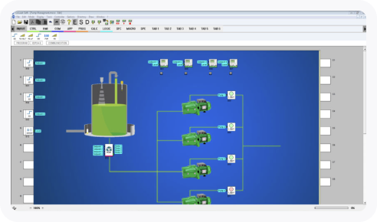

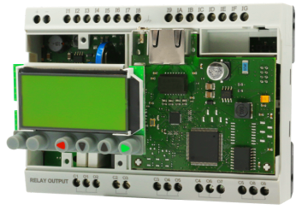

YOUR CUSTOM-MADE PRODUCT
Design Lab
DESIGN
LAB
From simple adaptations to custom designs
When your application requires more than standard products, our DesignLAB team, with 100+ experts in electromechanics, electronics & software, is ready to partner with you in the development of the best customized solution dedicated to your project.

Slide 14
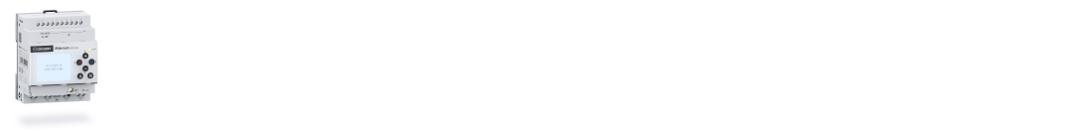
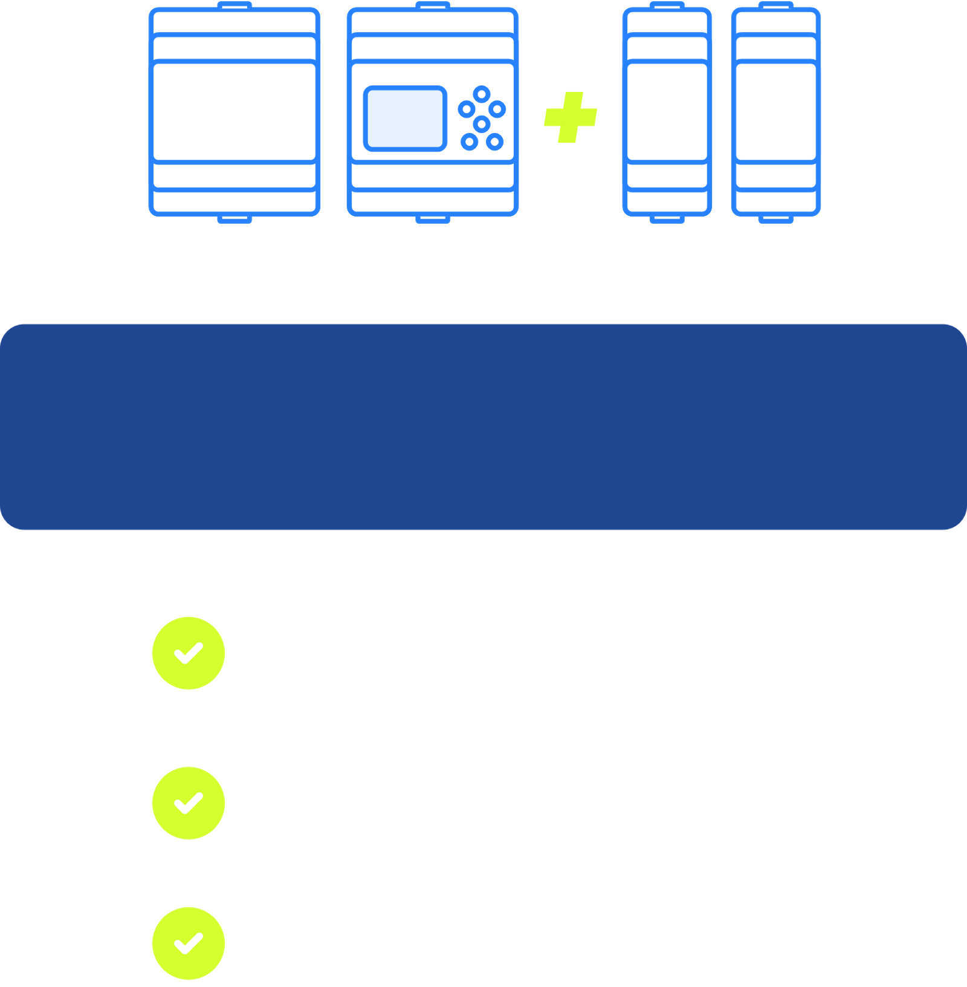
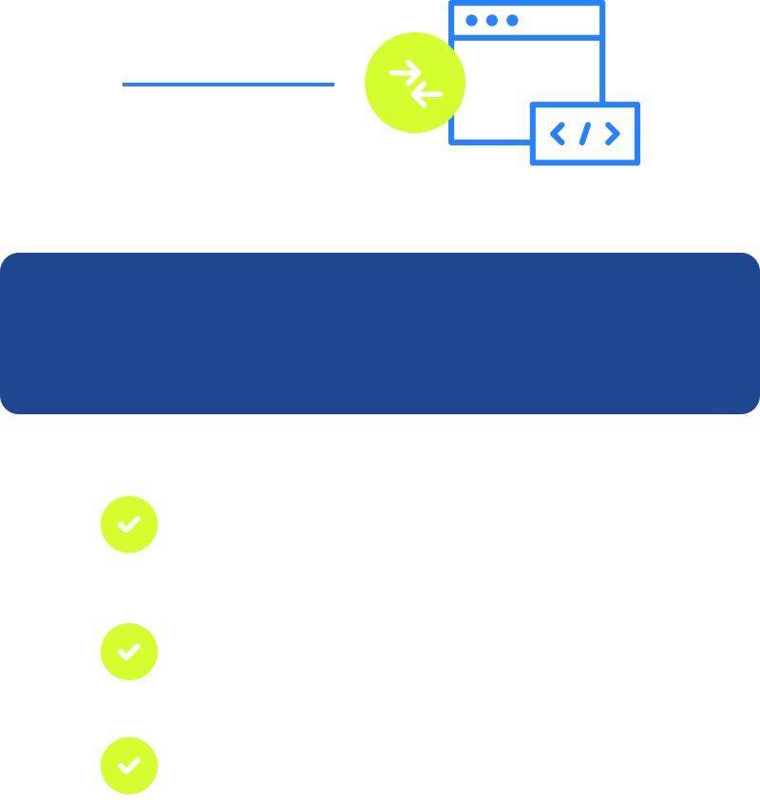
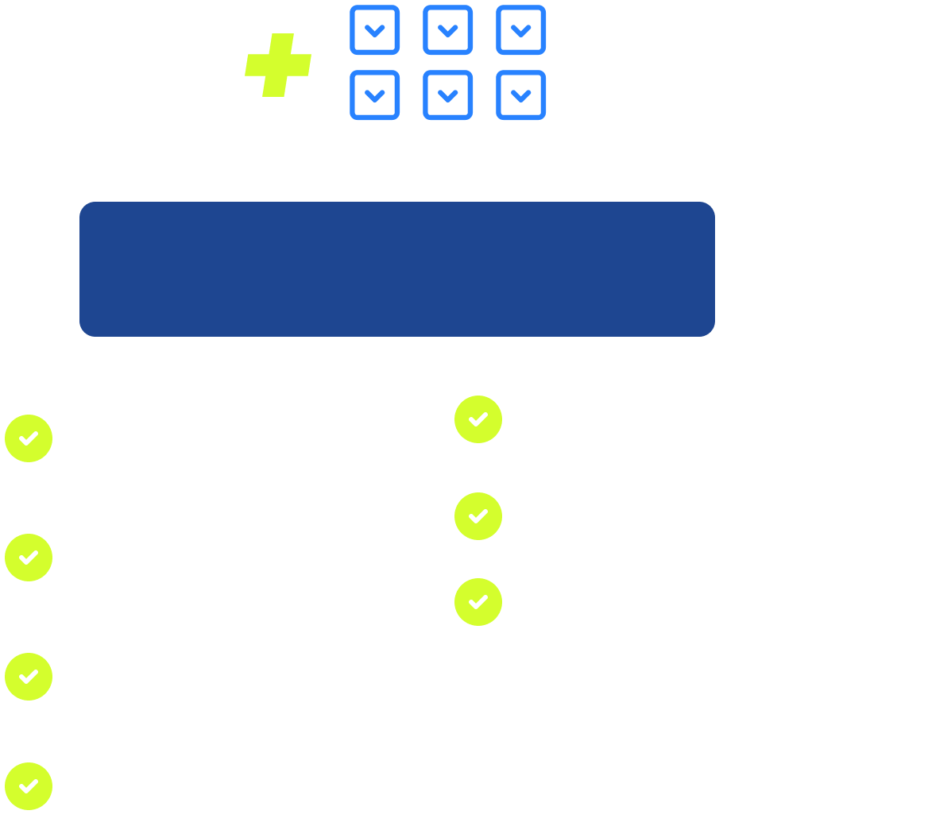
Easier, Better, Faster, Stronger
M3 Soft
Crouzet soft
Simplify
Compatibility
What's new
Modular offer
Compatible with existing programs
Integrated Ethernet
TCP/IP port
Up to 60
inputs/outputs
Simplify range with display or blind versions
Upgraded software with new features
3-color display
on 6 lines
Modbus RS-485 port
optional
All models now expandable
A more intuitive interface
Webserver
Memory interface
on SD card
Doubled
internal memory

Slide 15

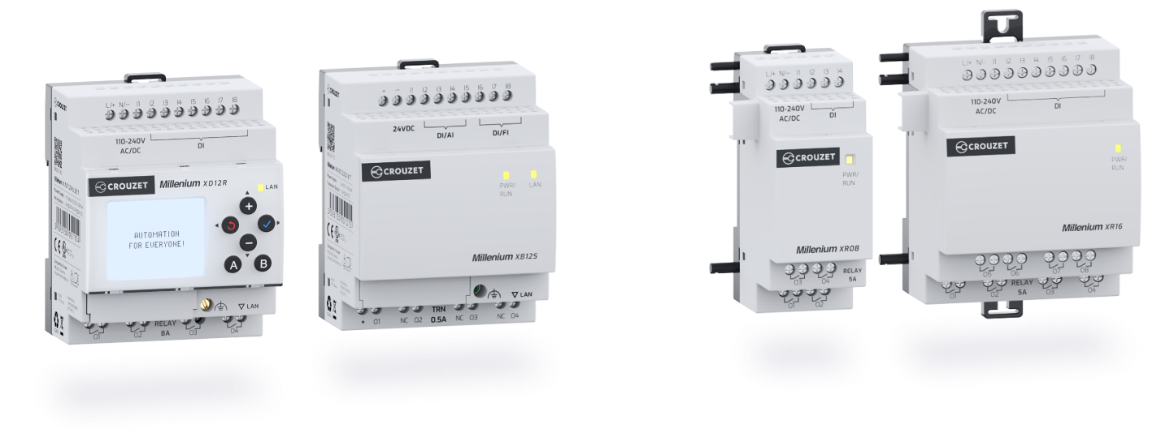



Millenium
The
®
range
New controller 12 I/Os
New expansions
With display and without display versions
Digital or Analog 35mm / Digital 70mm
view technical details

Slide 16

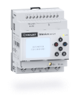



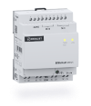
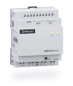



®
New controller 12 I/Os
The
Millenium
range
With display
Without display
MXD12RU3ET
MXD12RU1ET
MXD12SD1ET
MXD12RD7ET
MXB12RU3ET
MXB12RU1ET
MXB12SD1ET
MXB12RD7ET
DISPLAY
SIZE
SUPPLY
INPUTS
OUTPUTS
Expandable
COMMUNICATION
Datalog
Memory
SOFTWARE
Tricolor - 6 Lines
70 mm
110-230 V AC/DC
8 Digital
4 Relay - 8A
Yes, up to 60 I/Os
Ethernet, Modbus (with interface)
Yes
Memory Card
Tricolor - 6 Lines
70 mm
24 V AC/DC
8 Digital
4 Relay - 8A
Yes, up to 60 I/Os
Ethernet, Modbus (with interface)
Yes
Memory Card
Tricolor - 6 Lines
70 mm
24 V DC
4 Digital/Analog 4 Digital/HighSpeed
4 SSR/PWM – 0.3A
Yes, up to 60 I/Os
Ethernet, Modbus (with interface)
Yes
Memory Card
Tricolor - 6 Lines
70 mm
12-24V DC
4 Digital/Analog 4 Digital/HighSpeed
4 Relay - 8A
Yes, up to 60 I/Os
Ethernet, Modbus (with interface)
Yes
Memory Card
-
70 mm
110-230 V AC/DC
8 Digital
4 Relay - 8A
Yes, up to 60 I/Os
Ethernet, Modbus (with interface)
Yes
Memory Card
-
70 mm
24 V AC/DC
8 Digital
4 Relay - 8A
Yes, up to 60 I/Os
Ethernet, Modbus (with interface)
Yes
Memory Card
-
70 mm
24 V DC
4 Digital/Analog 4 Digital/HighSpeed
4 SSR/PWM – 0.3A
Yes, up to 60 I/Os
Ethernet, Modbus (with interface)
Yes
Memory Card
-
70 mm
12-24V DC
4 Digital/Analog 4 Digital/HighSpeed
4 Relay - 8A
Yes, up to 60 I/Os
Ethernet, Modbus (with interface)
Yes
Memory Card
view expansions

Slide 17











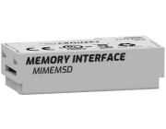
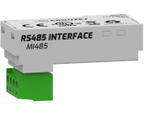
Millenium
The
®
range
New expansions
Digital 70mm
Digital 35mm
Analog 35mm
MXR16U3
MXR16U1
MXR16D7
MXS16D1
MXR08U3
MXR08U1
MXR08D7
MXS08D1
MXAI02D7
MXAO02D1
MXAI02PD7
SIZE
SUPPLY
INPUTS
OUTPUTS
70 mm
110-230 V AC/DC
8 Digital
8 Relay
70 mm
24 V AC/DC
8 Digital
8 Relay
70 mm
12-24 V DC
8 Digital
8 Relay
70 mm
24 V DC
8 Digital
8 SSR
SIZE
SUPPLY
INPUTS
OUTPUTS
35 mm
110-230 V AC/DC
4 Digital
4 Relay
35 mm
24 V AC/DC
4 Digital
4 Relay
35 mm
12-24 V DC
4 Digital
4 Relay
35 mm
24 V DC
4 Digital
4 SSR
SIZE
SUPPLY
INPUTS
OUTPUTS
35 mm
12-24 V DC
2 Analog (V/mA)
-
35 mm
24 V DC
-
2 Analog (V/mA)
35 mm
12-24 V DC
2 RTD
-
Memory Card Interface
RS485 interface

Slide 18


2025
THANK YOU FOR YOUR
ATTENTION!
For more information visit : www.crouzet.com

